Slide 1
Career project
Max Kirsh, SEWD1, 2025
Software Engineering

Slide 2
WHAT DO THEY DO?
Create computer applications
Analyzing and designing software to meet the needs of the user
Making sure a program runs correctly with no faults

Slide 3
Education & Skills
Bachelors degree/Masters
Communication
Problem solving
Team leadership

Slide 4
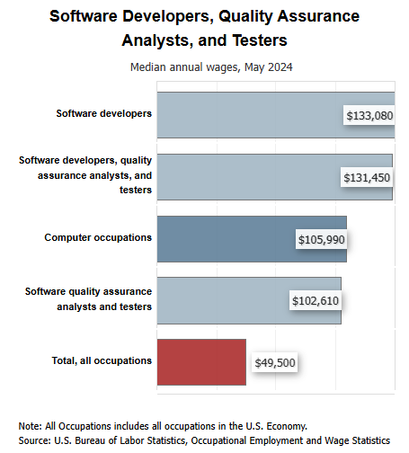
Software Developers, Quality Assurance Analysts, and Testers : Occupational Outlook Handbook: : U.S. Bureau of Labor Statistics
Salary
Software Devs Make Significantly more money than most computer based occupations

Slide 5
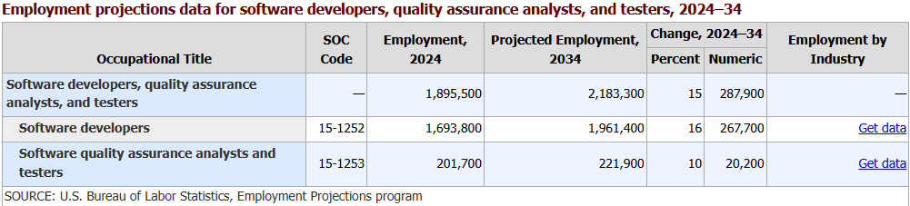
Software Developers, Quality Assurance Analysts, and Testers : Occupational Outlook Handbook: : U.S. Bureau of Labor Statistics
Job Outlook
Employment rates are up
This field of work is in high demand

Slide 6
Coursework Connections
SEWD1 gives all the basic fundamentals
Practice on all ends of this career
HTML, databases, and AI prompting

Slide 7
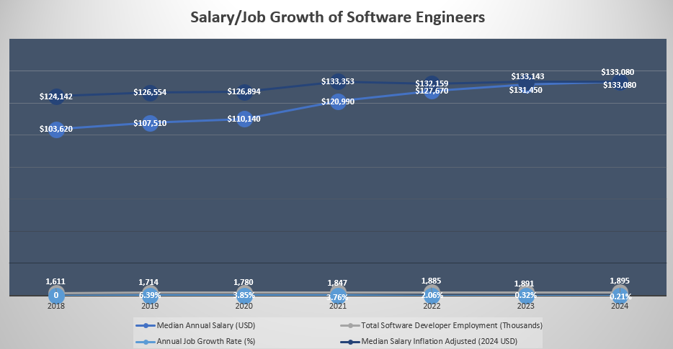
https://medinaccc-my.sharepoint.com/:x:/g/personal/mc_mkirsh27_mcjvs2_org/EQiLU-BdwEBOgotHyOGWOGwB3lky1uoe4qwUeLswO83pag
Trend Chart
Notes:
This chart shows the median annual salary/inflation adjusted, as well as the annual job growth rate and employment.

